Slide 1


Configure Virtual Machines

Slide 2



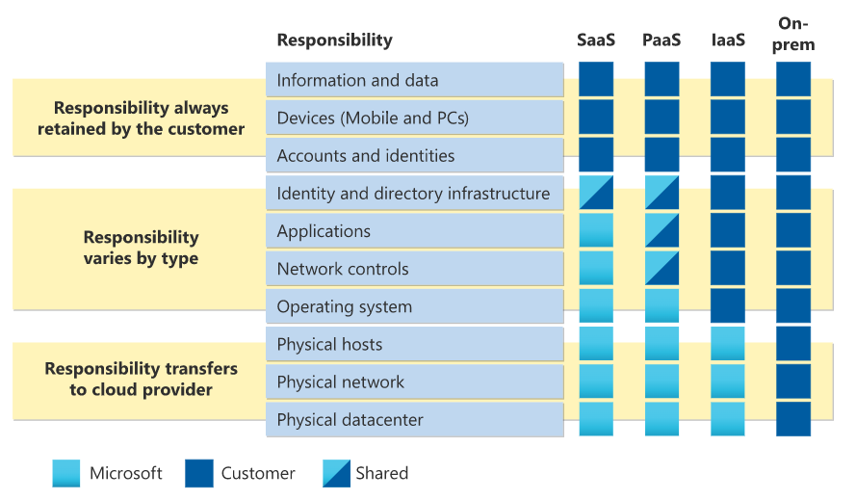
Review Cloud Services Responsibilities

Slide 3

Plan Virtual Machines
Start with the network
Name the virtual machine
Choose a location
Each region has different hardware and service capabilities
Locate Virtual Machines as close as possible to your users to ensure compliance and legal obligations
Consider pricing
70+ Azure regions
Available in 140 countries

Slide 4
Determine Virtual Machine Sizing
Type | Description
General purpose | Balanced CPU-to-memory ratio.
Compute optimized | High CPU-to-memory ratio.
Memory optimized | High memory-to-CPU ratio.
Storage optimized | High disk throughput and I/O.
GPU | Specialized virtual machines targeted for heavy graphic rendering and video editing.
High performance compute | Our fastest and most powerful CPU virtual machines

Slide 5



Determine Virtual Machine Storage
Each Azure VM has two or more disks:
  OS disk
  Temporary disk (not all SKUs have one, content can be lost)
  Data disks (optional)
Azure VM (Windows)
C:\
OS disk
D:\
Temporary disk
F:\
Data disk
OS and data disks reside in Azure Storage accounts:
  Azure-based storage service
  Standard (HDD, SSD) or Premium (SSD), or Ultra (SSD)
Azure VMs use managed disks
Azure blob

Slide 6
Demonstration – Creating a VM in the Portal
Create a virtual machine
Connect to the virtual machine – Bastion, RDP, or SSH

Slide 7
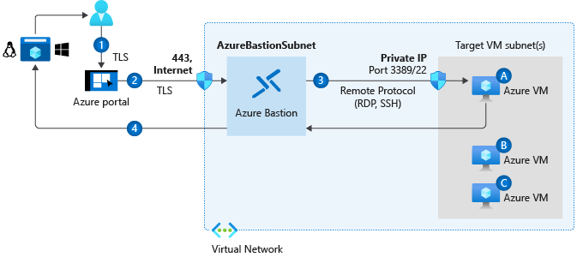
Connect to Virtual Machines
Bastion Subnet for RDP/SSH through the Portal over SSL
Remote Desktop Protocol for Windows-based Virtual Machines
Secure Shell Protocol for Linux based Virtual Machines

Slide 8
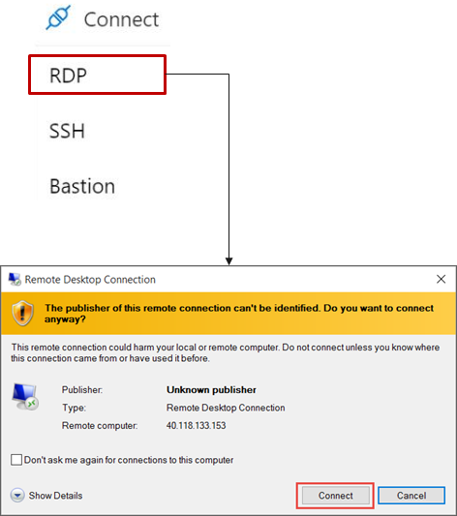
Connect to Windows Virtual Machines
Remote Desktop Protocol (RDP) creates a GUI session and accepts inbound traffic on TCP port 3389
WinRM creates a command-line session so you can run scripts

Slide 9
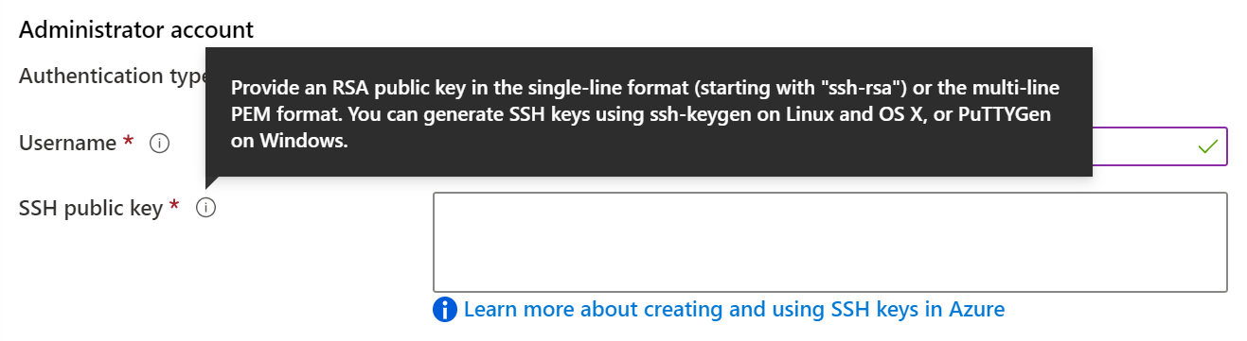
Connect to Linux Virtual Machines
Authenticate with a SSH public key or password
SSH is an encrypted connection protocol that allows secure logins over unsecured connections
There are public and private keys

Slide 10
Configure Virtual Machine Availability

Slide 11
Configure Azure Virtual Machine Availability Introduction
Plan for Maintenance and Downtime
Setup Availability Sets
Review Update and Fault Domains
Review Availability Zones
Compare Vertical to Horizontal Scaling
Create Scale Sets (2 student topics)
Configure Autoscale (2 student topics)
Demonstration – Virtual Machine Scaling
Learning Recap
Implement and manage Azure compute resources (20-25%): Create and configure virtual machines
Configure VM availability options
Deploy and configure VM scale sets

Slide 12
Plan for Maintenance and Downtime
Unplanned Hardware Maintenance
Unexpected
Downtime
Planned
Maintenance
When the platform predicts a failure, it will issue an unplanned hardware maintenance event
Action: Live migration
Unexpected Downtime
is when a virtual machine fails unexpectedly
Action: Automatically migrate (heal)
Planned Maintenance events are periodic updates made to the Azure platform
Action: No action

Slide 13
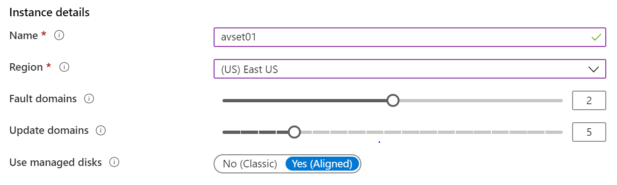
Setup Availability Sets
Two or more instances in Availability Sets = 99.95% SLA
Configure multiple Virtual Machines in an Availability Set
Configure each application tier
into separate Availability Sets
Combine a Load Balancer with Availability Sets
Use managed disks with the Virtual Machines

Slide 14
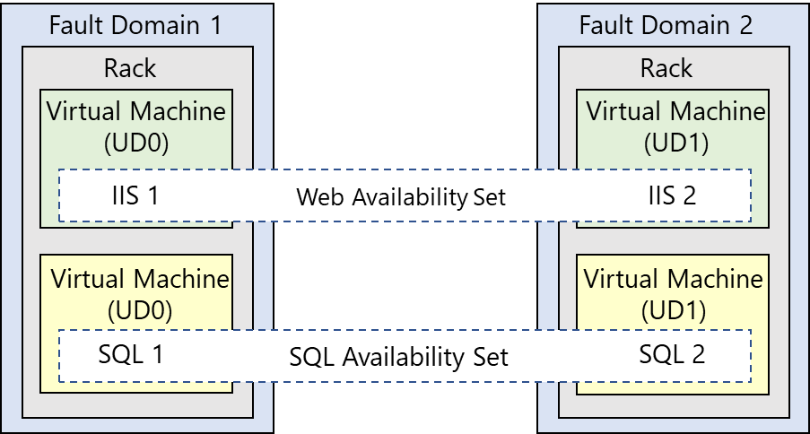
Review Update and Fault Domains
Update domains allows Azure to perform incremental or rolling upgrades across a deployment.
During planned maintenance,
only one update domain is rebooted at a time
Fault Domains are a group of Virtual Machines that share a common set of hardware, switches, that share a single point of failure. VMs in an availability set are placed in at least two fault domains
Notes:
Fault domain
Prevent Hardware failures like limit the impact of potential physical hardware failures, network outages, or power interruptions
1 Rack that share common power source and network switch.
Max- 3 FD per availability set, Default value=2
Update domain
Max= 20 UD, Default=5
Update domains indicate groups of virtual machines and underlying physical hardware that can be rebooted at the same time
The order of update domains being rebooted may not proceed sequentially during planned maintenance, but only one update domain is rebooted at a time. A rebooted update domain is given 30 minutes to recover before maintenance is initiated on a different update domain.

Slide 15
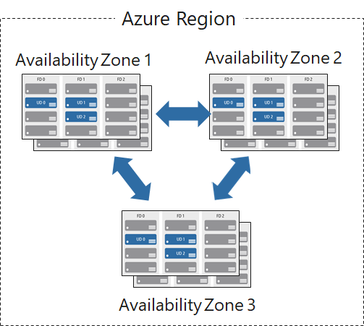
Review Availability Zones
Unique physical locations
in a region
Includes datacenters with independent power, cooling, and networking
Protects from datacenter failures
Combines update and
fault domains
Provides 99.99% SLA​

Slide 16
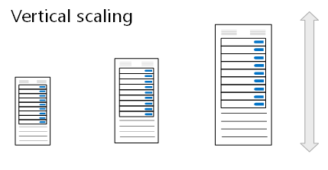
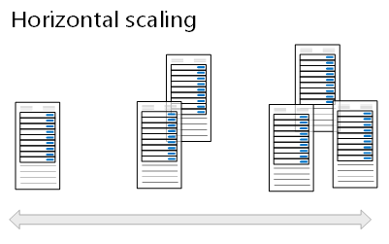
Compare Vertical to Horizontal Scaling
Vertical scaling (scale up and scale down) is the process of increasing or decreasing power to a single instance of a workload; usually manual​
Horizontal scaling (scale out
and scale in) is the process of increasing or decreasing the number of instances of a
workload; frequently automated

Slide 17
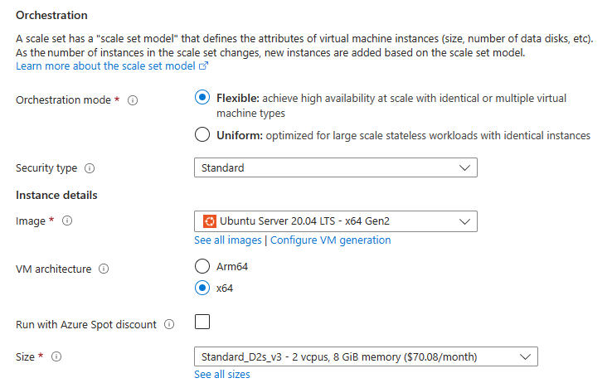
Create Scale Sets
Instance count. Number of VMs in the scale set (0 to 1000)
Instance size. The size of each virtual machine in the scale set
Azure Spot Instance. Unused capacity at a discounted rate
Use managed disks
Enable scaling beyond 100 instances

Slide 18
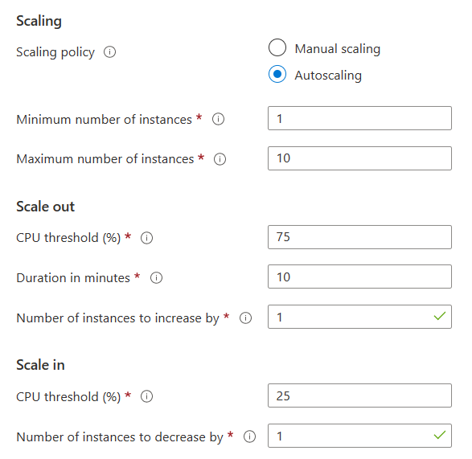
Configure Autoscale
Define a minimum, maximum, and default number of VM instances
Create more advanced scale sets with scale out and
scale in parameters

Slide 19
Demonstration – Virtual Machine Scaling
Configure Virtual Machine Scale Sets
Review manual scaling, scale-in policies, and custom scaling options

Slide 20
LAB – Manage Virtual Machines

Slide 21
Lab 08 – Manage Virtual Machines
Job Skills
Task 1: Deploy zone-resilient Azure virtual machines by using the Azure portal.
Task 2: Manage compute and storage scaling for virtual machines.
Task 3: Create and configure Azure Virtual Machine Scale Sets.
Task 4: Scale Azure Virtual Machine Scale Sets.
Task 5: Create a virtual machine using Azure PowerShell (option 1).
Task 6: Create a virtual machine using the CLI (option 2).
In this lab, you compare manual scaling of virtual machines to automatic scaling of virtual machines.
You learn how to configure and resize a single virtual machine.
You learn how create a virtual machine scale set and configure autoscaling.
Optionally, you learn to use scripting to deploy a virtual machine.

Slide 22



Lab 08 – Architecture diagram
Azure Virtual Machines
Virtual Machine Scale Sets
Task 1
Task 3
az104-vm1
az104-vm2
Zone1
Zone2
vmss1
Zone 1, 2, 3
Task 2
Task 4
resize and update
custom auto scale rules
Task 5: Create a virtual machine using Azure PowerShell (option 1)
Task 6: Create a virtual machine using the CLI (option 2)

Slide 23








Lab 08 – Architecture diagram (interactive lab simulation)
Task 1
Task 2
Task 3, Task 4, Task 5, Task 6, Task 7
az104-08-rg01
az104-08-rg02
az104-06-vnet01 10.80.0.0/20
az104-08-rg02-vnet 10.82.0.0/20
Subnet0 10.80.0.0/24
Subnet0 10.82.0.0/24
az10408rg01diag938
az104-08-vm0
10.80.0.4
az104-08-vm1
10.80.0.5
az10408vmss0
az10408vmss0-lb
Zone1
Zone2
scripts
az10408vmss0-nsg
az10408vmss0-ip
az104-08-install_IIS.ps1

Slide 24
Thank You!

